Slide 1
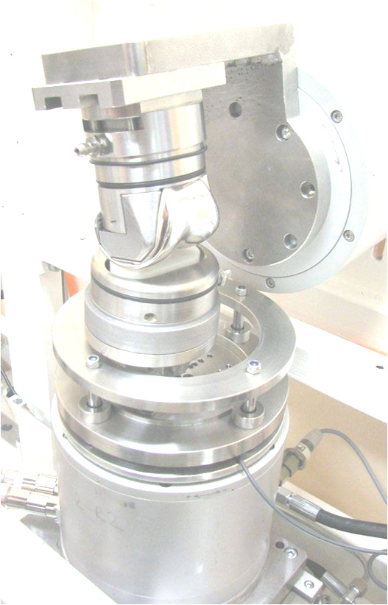
Simulator KKK ELO 2011
Laboratory of Biotribology
Laboratory of Biomechanics
Department of Mechanics,
Biomechanics and Mechatronics
Faculty of Mechanical Engineering
Czech Technical University in Prague

Slide 2
Simulator KKK ELO 2011
Simulator is primarily designed for realistic simulating of wear tribology of human joints. Kinematics and dynamics may be set according to relevant ISO standards (ISO 14243 for Total Knee Replacements). In addition, experiments are conducted under conditions that represent the real activities and conditions of daily living.

Slide 3
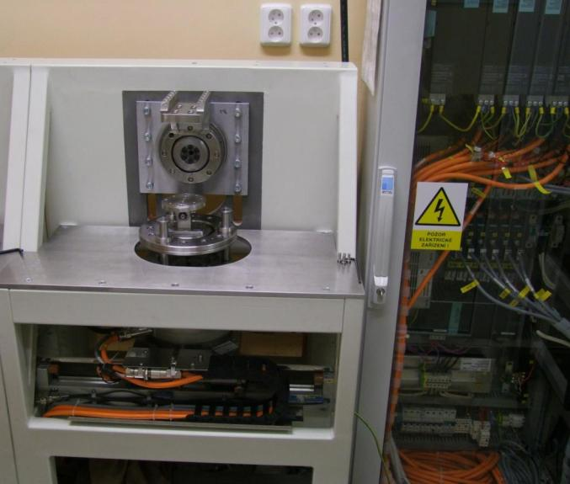
Tuhý svařovaný rám
Elektrický rozvaděč
Uchycení femorální části
Rotační motor
Uchycení tibiální části
Přesné posuvné vedení
Rotační motor (s hydraulickým válcem uvnitř)
Lineární motor

Slide 4
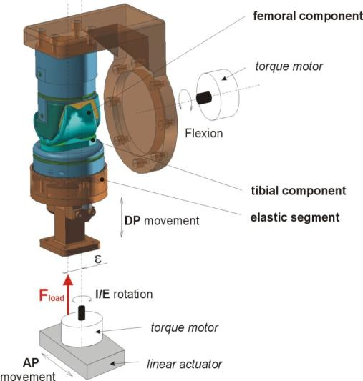
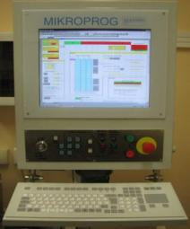
4 DOF
Axial force
Monitoring of forces
and moments
Controlled and monitored by commercial software (Siemens)

Slide 5
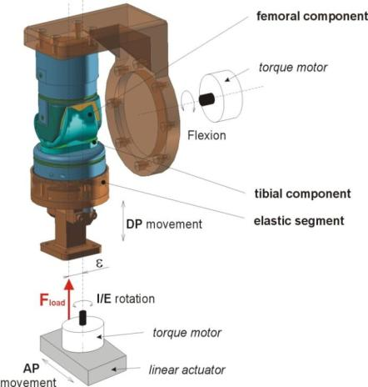
Detailed information (parameters of the simulator)
Range of motions:
Flexion-extension and internal-external rotation
(torque motors): 0-360° (theoretically)
Anterior-posterior movement
(linear motor): ±40mm
Distal-proximal movement
(hydraulic system): ±40mm (uncontrolled position, controlled force)

Slide 6
Parameters of linear motor
Prarameters of torque motors
Peak force (for 1s): 1700 N
Continuous force: 605 N
Accuracy: ±0,005 mm/300mm
Peak moment (for 1s): 39 Nm
Continuous force: 14 Nm
Accuracy: 18 arc sec (0,005°)
Parameters of hydraulic actuator
Maximal pressure in hydraulic system: 16kPa
Force range: ±5kN
Parameters of load cells (forces, moments)
1 DOF load cell or 6 DOF load cell
Full scale (FS): 1,25/2,5/5 kN
Static error band: ± 0,03 %FS
(Highly accurate measureing of the contact force in the vertical direction)
Full scale (FS): Fx, Fy: 1,9kN
Fz: 3,8kN
Mx, My, Mz: 80 Nm
(Lower accuracy, but possibility to measure all 3 forces and 3 moments)

Slide 7
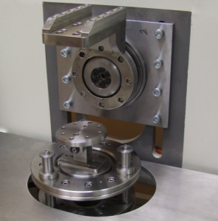
Parameters of the assembly
Horizontal stiffness
Force [N] | 100 | 500 | 1000 | 1500 | 2000 | 2500 | 3000 | 3500 | 4000 | 4500 | 5000
abs. displacement [µm] |  | -0.06 | 0.74 | 1.30 | 1.82 | 2.31 | 2.66 | 2.93 | 3.18 | 3.70 | 4.02
Vertical stiffness*
Force [N] | 100 | 500 | 1000 | 1500 | 2000 | 2500 | 3000 | 3500 | 4000 | 4500 | 5000
abs. displacement [µm] |  | -0.12 | 21.58 | 42.16 | 62.83 | 83.61 | 104.59 | 125.74 | 146.89 | 189.19 | 210.55
*The force in the vertical direction is more important than a position. The force is accurately regulated by feedback control loop.
Vertical
Horizontal

Slide 8
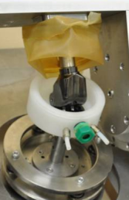
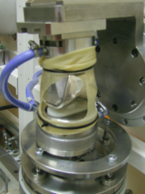
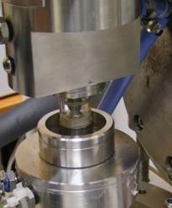
Experiments
The simulator KKK ELO 2011 is primarily developed for testing of knee implants, but its universality allows us to perform wear tests with various sample geometries.
Examples / History
Anatomic knee endoprosthesis
„Small samples“ (8mm balls)
Hinge-type knee endoprosthesis
Tested material combinations (up to now): various Ti and Co-Cr-Mo alloys with or without surface treatment (e.g. DLC coating) against PEEK, PE, UHMWPE, ceramics,..)

Slide 9
Evaluation of wear
Mass/volume wear rate (weighing-machine with a resolution of 10⁻⁵g)
Profile of damaged surface 4D - profilometer developed specifically for scanning of typical prosthesis geometries (accuracy under 1μm)
Cumulative distribution of wear particles
A change of surfaces morphology
Geometry and size of wear particles
Additional controlled conditions
Temperature (samples are usually heated to 37°C)
Lubricant (Bovine serum, physiological solution, distilled water, …)
pH (controlled by pH meter) and volume of lubricant
Corrosive potential (measuring of voltage between a sample and a reference electrode submerged in lubricant – useful tool, how to check sudden changes in quality of passivated surface)
Amount of wear particles in lubricant
Frequency/velocity of loading
The simulator works in a very clean and controlled environment (humidity, room temperature, dust)

Slide 10
Near future plan
Loading cycle
An example of a loading cycle for normal gait (4 km/h)
To add the force feedback control according to the forces and moments on motors
To add another DOF for testing of hip joint endoprosthesis according to a standard ISO 14242
To develop and test new geometry of small samples and a test cycle

